Slide 1
SQL Project -
E-commerce Sales Analysis
Business Problem - A E-commerce Company, wants you to help them understand how their sales trend across different states over the years and why?.

Slide 2
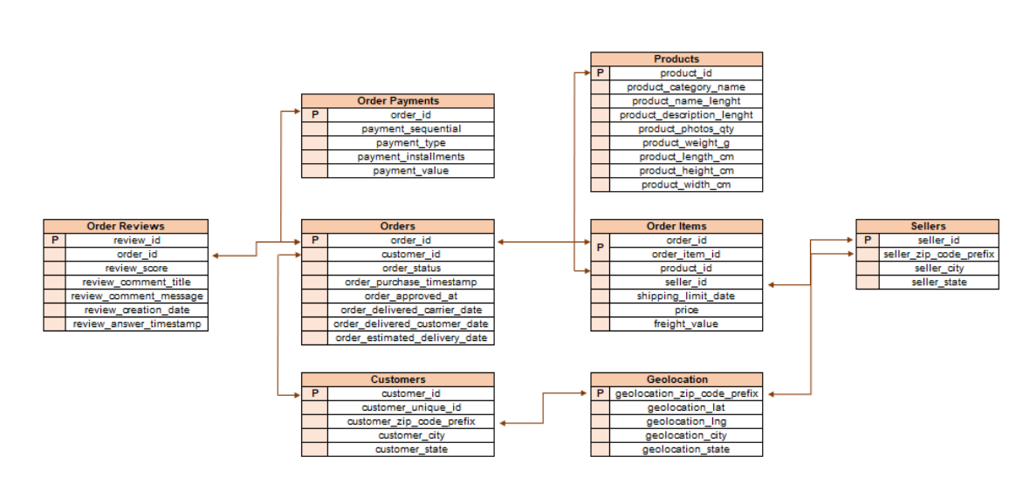
E-commerce Sales Analysis Schema

Slide 3
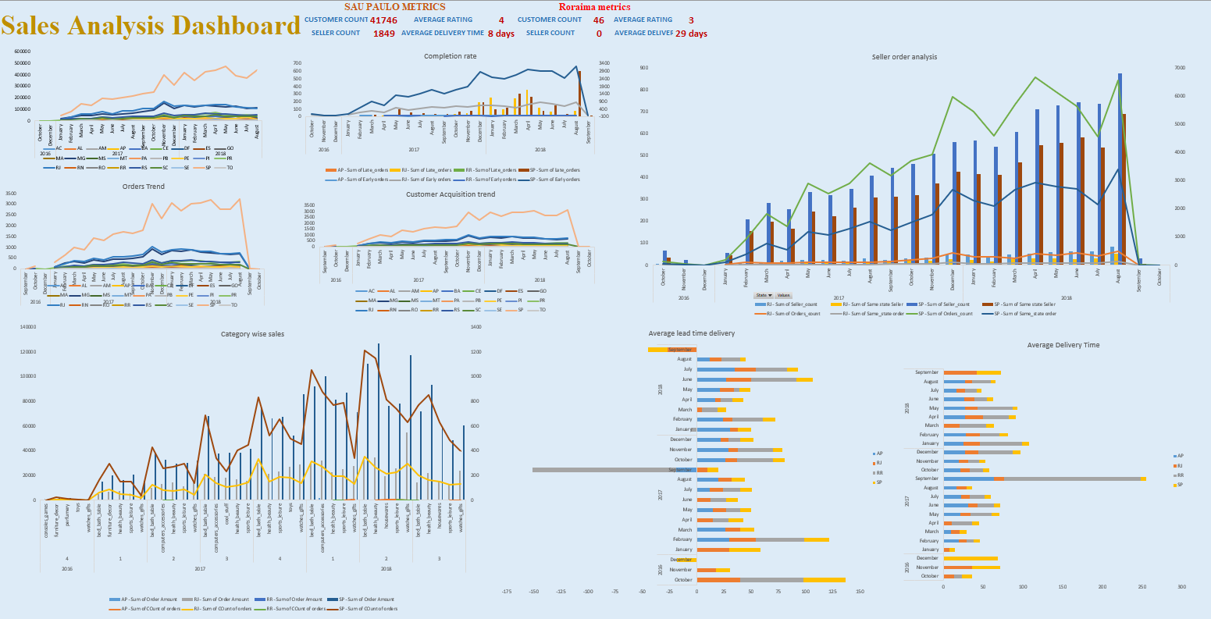
E-Commerce Sales Analysis Dashboard (ScreenShot)

Slide 4
Approach – To view trends following states over the years, we plotted the data month-wise and year-wise.
To extract the data we joined the customers table, orders, and payments table and sum the total order value and group by month, year of purchase, and customer state.
We considered only completed orders

Slide 5
Approach (for Orders Trend) – To view Orders trend over months and years, we plotted the count of total orders placed for each state.
To extract data we joined customers table and orders table after it we did group by month and year of purchase and customers’ state.
Approach(for Customer Acquisition trend) - To view customers trend over months and years, we plotted the count of total customers who placed their first order for each state.
To extract data first we rank the order placed by customers by date of purchase and then joined this with customers table with a condition where rank was 1. After it we did group by customers -state ,month and year of purchase

Slide 7
After plotting all the three metrics, we shortlisted the top 2 and bottom 2 states on the following criteria
Orders- Total orders count
Customers Acquisition – Count of new customers
Total sale – Total sale Amount
We got the following results-
Top 2 performing states - SP, RJ
Bottom 2 performing states – RR, AP

Slide 8
Average delivery time is the time between order purchase time and order delivery time, we expect that time as least as possible.
We can see here for the top 2 performing states have almost the same delivery time across months and years with
Low average delivery time in comparison to bottom-performing states.
Average lead delivery time is a measure of how much earlier than the expected delivery time. We expect this value as higher as possible and always a positive value.
We can see here that there are no major changes in time and we can not see any trend in top-performing states. whereas
In low performing state, that time is negative and it fluctuates a lot.

Slide 9
This graph shows us how many orders and sellers are in a particular state and how many orders are placed by customers from the same state.
We can see here with increasing time the total orders for sellers are increasing as well as the number of sellers also increasing.
Among these increasing orders for the seller number of orders from the same state is also increasing. This might be because of an increasing number of sellers as well as the average delivery time remains the same and does not increase and also processing time does not fluctuate.

Slide 10
Order distribution across states
customer_state | AC | AM | BA | CE | DF | ES | GO | MA | MG | MS | MT | PA | PB | PE | PI | PR | RJ | RN | RO | RS | SC | SE | SP | count_
AC | 0 | 0 | 1 | 0 | 1 | 0 | 1 | 1 | 10 | 1 | 0 | 0 | 0 | 0 | 0 | 1 | 1 | 0 | 0 | 2 | 4 | 0 | 55 | 81
MA | 0 | 1 | 16 | 2 | 8 | 2 | 9 | 0 | 67 | 0 | 3 | 0 | 1 | 5 | 1 | 42 | 29 | 0 | 0 | 14 | 22 | 0 | 502 | 747
PB | 0 | 0 | 10 | 1 | 8 | 0 | 7 | 4 | 46 | 0 | 2 | 0 | 0 | 8 | 1 | 40 | 24 | 2 | 0 | 8 | 19 | 0 | 343 | 536
RJ | 0 | 0 | 84 | 10 | 100 | 61 | 58 | 41 | 1179 | 9 | 13 | 0 | 10 | 43 | 1 | 992 | 0 | 2 | 2 | 247 | 481 | 1 | 8197 | 12852
RO | 0 | 0 | 3 | 1 | 0 | 1 | 1 | 0 | 14 | 0 | 2 | 0 | 0 | 3 | 0 | 18 | 13 | 0 | 0 | 10 | 9 | 0 | 162 | 253
AL | 0 | 1 | 8 | 2 | 4 | 0 | 6 | 4 | 35 | 0 | 0 | 0 | 1 | 9 | 0 | 39 | 13 | 1 | 0 | 10 | 11 | 0 | 258 | 413
CE | 0 | 0 | 14 | 0 | 15 | 3 | 12 | 9 | 75 | 0 | 2 | 0 | 2 | 17 | 1 | 66 | 57 | 3 | 0 | 12 | 23 | 0 | 996 | 1336
ES | 0 | 0 | 11 | 3 | 19 | 0 | 5 | 13 | 176 | 0 | 2 | 0 | 1 | 17 | 0 | 110 | 100 | 0 | 1 | 24 | 52 | 1 | 1452 | 2033
PE | 0 | 0 | 32 | 5 | 10 | 6 | 11 | 22 | 113 | 0 | 6 | 0 | 2 | 0 | 1 | 89 | 94 | 0 | 0 | 17 | 41 | 2 | 1141 | 1652
PR | 0 | 0 | 11 | 5 | 25 | 15 | 8 | 9 | 366 | 4 | 8 | 1 | 0 | 9 | 1 | 0 | 203 | 4 | 1 | 140 | 288 | 1 | 3111 | 5045
RN | 0 | 0 | 9 | 1 | 6 | 2 | 1 | 3 | 29 | 0 | 1 | 0 | 1 | 4 | 0 | 20 | 23 | 0 | 0 | 7 | 14 | 0 | 335 | 485
SE | 0 | 0 | 9 | 3 | 3 | 1 | 0 | 6 | 35 | 0 | 0 | 0 | 1 | 7 | 0 | 23 | 18 | 0 | 1 | 8 | 16 | 0 | 209 | 350
AM | 0 | 0 | 1 | 1 | 0 | 0 | 2 | 1 | 13 | 0 | 0 | 0 | 0 | 0 | 0 | 11 | 9 | 0 | 0 | 5 | 4 | 0 | 96 | 148
AP | 0 | 0 | 2 | 0 | 0 | 0 | 1 | 1 | 3 | 0 | 0 | 0 | 0 | 1 | 0 | 2 | 1 | 0 | 0 | 3 | 4 | 0 | 49 | 68
BA | 0 | 0 | 0 | 3 | 35 | 23 | 8 | 9 | 372 | 3 | 4 | 0 | 2 | 26 | 0 | 146 | 137 | 5 | 1 | 42 | 84 | 0 | 2327 | 3380
DF | 0 | 0 | 17 | 1 | 0 | 1 | 29 | 27 | 191 | 4 | 7 | 0 | 1 | 16 | 0 | 153 | 103 | 1 | 0 | 48 | 70 | 0 | 1381 | 2140
MS | 0 | 0 | 2 | 1 | 7 | 0 | 8 | 3 | 64 | 0 | 5 | 0 | 0 | 2 | 0 | 55 | 33 | 0 | 0 | 16 | 31 | 0 | 472 | 715
MT | 0 | 0 | 5 | 1 | 12 | 6 | 9 | 4 | 54 | 2 | 0 | 0 | 1 | 1 | 0 | 64 | 30 | 0 | 0 | 22 | 28 | 0 | 643 | 907
SC | 0 | 0 | 16 | 2 | 21 | 13 | 10 | 18 | 259 | 1 | 5 | 0 | 0 | 9 | 1 | 394 | 117 | 1 | 0 | 118 | 0 | 0 | 2311 | 3637
TO | 0 | 0 | 2 | 0 | 5 | 2 | 5 | 2 | 16 | 0 | 0 | 0 | 0 | 1 | 0 | 16 | 14 | 0 | 0 | 4 | 12 | 0 | 198 | 280
GO | 0 | 0 | 8 | 1 | 31 | 3 | 0 | 16 | 155 | 1 | 10 | 0 | 1 | 12 | 0 | 91 | 110 | 0 | 0 | 23 | 56 | 1 | 1419 | 2020
MG | 0 | 1 | 53 | 4 | 103 | 45 | 85 | 31 | 0 | 4 | 20 | 1 | 2 | 61 | 2 | 825 | 563 | 1 | 0 | 190 | 439 | 0 | 7378 | 11635
PA | 0 | 0 | 8 | 3 | 11 | 3 | 10 | 5 | 86 | 0 | 3 | 0 | 1 | 5 | 0 | 56 | 38 | 1 | 0 | 22 | 19 | 1 | 682 | 975
PI | 0 | 0 | 9 | 3 | 8 | 2 | 2 | 5 | 32 | 0 | 0 | 0 | 0 | 8 | 0 | 26 | 23 | 0 | 0 | 11 | 19 | 0 | 335 | 495
RR | 0 | 0 | 1 | 0 | 0 | 0 | 0 | 0 | 3 | 0 | 0 | 0 | 0 | 0 | 0 | 5 | 0 | 0 | 0 | 0 | 1 | 0 | 35 | 46
RS | 0 | 0 | 19 | 1 | 22 | 19 | 13 | 17 | 285 | 1 | 6 | 0 | 0 | 13 | 0 | 590 | 207 | 4 | 1 | 0 | 299 | 0 | 3577 | 5466
SP | 1 | 0 | 141 | 25 | 313 | 102 | 130 | 124 | 2607 | 18 | 32 | 5 | 8 | 105 | 2 | 2967 | 1369 | 5 | 7 | 680 | 1338 | 2 | 0 | 41746

Slide 11
Insights
Lowest performing states do not have sellers from their own states so the delivery time is increased which affects customer satisfaction. So there’s a need to increase sellers in each state.
In recent months of 2018 lead Delivery time has gone in negative even for high-performing states which in turn causes low customer acquisition and may lead to loss of customers.
Max undelivered orders had a credit card as payment type followed by boleto then vouchers. So they can check the system.
Most states most ordered product is not delivered from the same state. So need to find sellers for that particular product in the same states.
Ramiro lowest-performing state has an average reply time for a complaint of 198 hours whereas in other states it’s around 35-70 hours. Also another state AP has an overall average reply time of 104 hours whereas others have about 75-90 which is also high. Replying time to complaints as well as other reviews must be reduced.
Most sequential are paid in vouchers with most of the customers opting for 2 sequential.
Most of top-selling products have large descriptions so, tell sellers to add descriptions to their products.

